Slide 1
Data Modeling Concepts Part 3
<Data Model 101 Series>
Anand Kumar
Notes:
Hi. This is the part 3 of the Data modeling concepts series of presentations. From part 1 and part 2 of this series, you must have garnered good knowledge on what a data model is, its constructs, its types and more. In the following slides, we shall learn more on the established notations and its usage in the data warehousing field.
© 2009 Wipro Ltd – Internal & Restricted
‹#›

Slide 2
Data Modeling Overview
A method by which the enterprise business model is defined in terms of data elements and the relationships existing among those data elements.
Provides data view of the business model in a graphical representation of data elements as entity sets and business rules as relationships lines connecting the entity sets.
The data modeling details are covered in three parts,
Part 1 – Introduction to Database System and Context of Data Modeling.
Part 2 & 3 - Data Modeling terms and concepts and Data Modeling in Data Warehouse environment.
Notes:
This slide repeats itself to bring to you an overview of data model which will help you understand this presentation better.
Data Modeling is a process by which the enterprise business model is defined in terms of data elements and the relationships existing among those data elements.
The enterprise business models are like order processing system, dispatch system, employee management system etc. These are based on the various processes that can exist inside the enterprise. Each process is defined in terms of data elements and the business rules. Data modeling is the logical structuring of these elements and rules.
There are many benefits of Data modeling such as:
-Easy access to information and easy modification of information.
-Less storage space as data redundancy is reduced and so less cost of data maintenance.
-Easy to incorporate new changes and scalable. A business model goes through changes overtime, the data model provides the flexibility to adopt these changes.

Slide 3
Data Modeling Objectives
Upon completion of this module you will be able to:
Familiarize with terms and concepts of Data Modeling
What Data Model is used in Data Warehouse
Notes:
Data modeling is carried out based on certain standards. The entity type, attribute, relationship are part of data modeling standards.
Particular notation is followed to represent these terms. There are multiple notation methodologies, but we will cover IE i.e. Information Engineering Notation. This is widely used in our industry.
Upon completion of this module you should be able to
-Familiarize with terms and concepts of Data Modeling more easily
-Know the Data Model used in a Data Warehouse

Slide 4
Data Modeling Outline
Lesson 1 Data Modeling – Terms and Concepts
Lesson 2 Data Modeling In Data Warehouse
Notes:
This module has 2 Lessons.
Data Modeling- Terms and Concepts and
Data modeling in Data Warehouse.
© 2009 Wipro Ltd – Internal & Restricted
‹#›

Slide 5
Data Modeling – Terms & Concepts
Primary Key, Relationship, Foreign Key
Notes:
Data modeling follows its own terms and concepts. These terms and concepts are for storing the data in a meaningful way so that the data extraction and data manipulation becomes easy, transparent and manageable. This also helps in extension of data model to incorporate new process in it. Suppose that a company has an enterprise data warehouse and two data marts developed from it. A third data mart can be easily integrated into the system because it will pick up the data from the structured and organized data warehouse.
In part 2 under Data modeling terms and concepts, the entity type, attribute and metadata had been already explained.
So here, shall focus more on the relationship, primary key and foreign key concepts.
© 2009 Wipro Ltd – Internal & Restricted
‹#›

Slide 6
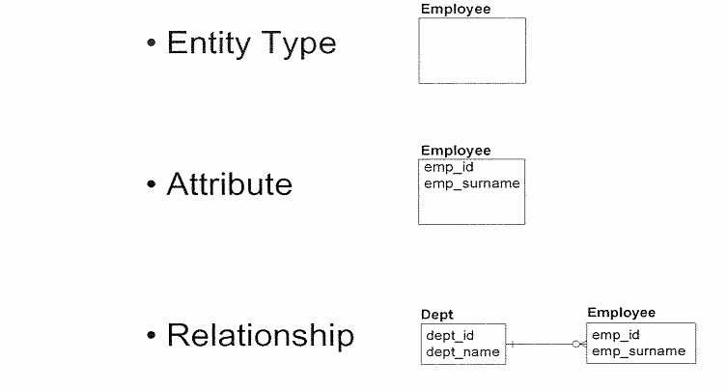
Basic Constructs
A data model is composed of three basic constructs: entity types, attributes and relationships.
Notes:
A data model is composed of three basic constructs: entity types, attributes and relationships.
As a recap on Entity type and attribute: An entity type is a type of person, place, thing, concept or event which an organization must manage and for which data is stored.
Examples of entity types include those of customer, employee, location, order, vendor, part etc.
An attribute is a characteristic that describes an entity type and is typically expressed as a noun qualified by an adjective. The Employee type has Employee id and employee surname as attributes.
The relationship shows the relation between two entity types. It also represents the business rule.
The department has employees or Employee belong to a department form the relationship between Employee and Department.

Slide 7
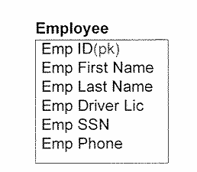
Primary Key
A primary key uniquely distinguishes one occurrence of an entity type from another.
A primary key consists of one or more identifying attributes, each of which is labeled as “(pk)”.
Notes:
A primary key uniquely distinguishes one occurrence of an entity type from another.
The features of primary key are:
A primary key consists of one or more identifying attributes, each of which is labeled as “(pk)”.
A primary key contains not null values.
An entity type has only one primary key.
In the example the Employee Id is the primary key.
From the given attributes of an entity type, one or more attributes are chosen to form the primary key. There can be more than one combination of attributes which can become primary key, but one should keep in mind to choose the combination which has the minimum number of attributes to uniquely define the record.
For example all the attributes of the employee together can be made the primary key. Or the Employee id and Employee first name can be primary key or even better, just the Employee Id can be made the primary key.
Form these, only Employee Id as the primary key is the best option. There are other normalization principles used to pick up the primary key. More on this is provided in Advanced Data modeling concepts.

Slide 8
Rules for Primary Key
Each entity type must have only one primary key.
The value of a primary key must correspond to one and only one occurrence of the entity type.
A primary key consists of one or more identifying attributes, each of which must always be present.
Notes:
The basic rules for primary key are:
-Each entity type must have only one primary key. This key could consist of one or more than one attributes depending on which combination best serves for the uniqueness of the record.
-Primary key helps in filtering duplicate records while data is inserted.
-The value of a primary key must correspond to one and only one occurrence of the entity type. The combination of Employee first name and last name can not be considered to be primary key as there can be multiple employees whose first name and last names can be same.
-A primary key consists of one or more identifying attributes, each of which must always be present. A null cannot be part of primary key since null has no meaning and it is not unique.

Slide 9
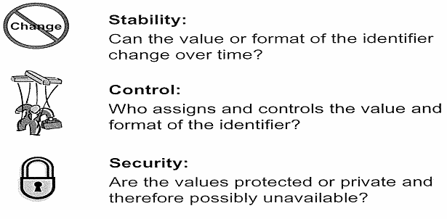
Primary Key – Logical Considerations
When deciding which attribute should be used as an identifier, three mail factors should be considered:
Stability – Identifying values should be stable and should never change once they have been assigned.
Control – Externally–controlled values could possibly change over time (e.g. zip code, social security number, etc.). While they can be used, it is best to avoid using these values if possible with a few exceptions.
Security – It is best to use values that you can openly use and/or request (e.g. internally created numbers like Employee Id).
Notes:
From the business and functional perspective, to decide upon the attributes to be used as primary key, three main factors should be considered:
Stability –The attribute value should not change over the time. For e.g. Employee location cannot become primary key, since its value can change. The Employee can move from one location to other location. Today the employee location is Bangalore,tomorrow it can be Mumbai. But the employee id does not change.
Control – Externally–controlled values could possibly change over time. For e.g. zip code, social security number etc. The employee social security number is a unique number given to each employee in U.S.A. It can be considered as primary key but it is not advised to use it. The format of social security no can change tomorrow or after the death of one person the number can be given to other person. The control of social security number is not in the company’s hand but somewhere else.
Security – It is best to use values that one can openly use. For e.g. internally created numbers like Employee Id. This number is easy to work with and it is not externally controlled. The number range can be defined as per the business requirements.

Slide 10
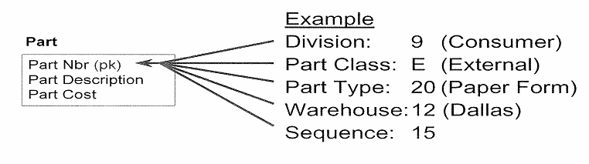
Smart Code – Definition & Example
A smart code is a single identifying attribute made up of multiple values.
For e.g. Part number 9E201215 can be defined as:
Division 9 - Consumer Services
Part Class E - Externally produced
Part type 20 - Paper Form
Warehouse 12 - Dallas
Sequence - 15
If the “intelligence” built into the code changes, the key must be changed as all the existing occurrences.
It that key is referenced by a relationship, it will require even further changes.
Notes:
What is a smart code: A smart code is a single identifying attribute made up of multiple values.
For e.g. Part number 9E201215 can be defined as:
Division 9 is Consumer Services
Part Class E is Externally produced
Part type 20 is Paper Form
Warehouse 12 is Dallas
Sequence is 15.
The smart code has a drawback in that “ it is externally controlled or privately controlled by one department.” The logic of smart code can change over time, for e.g. Warehouse 12 can be changed to warehouse 12A or Dallas can have warehouse number 14. With this change the key value also need to be changed.
The primary key is also physically present in entity types where it is referred to as a foreign key, hence it adds more difficulty to change the values in those places also.
It is best to avoid the smart keys as primary keys.

Slide 11
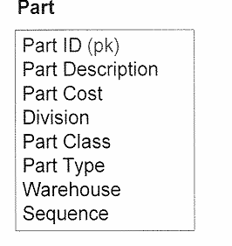
Smart Code - Resolution
Smart codes are usually holdovers from legacy systems and should not be used as primary keys.
Replace the smart code with an appropriate primary key and model individual elements of the smart code.
Create system generated identifier
Decompose multi valued attributes
Notes:
The alternatives to The smart key could be:
-System generated identifier : Instead of smart code, a system generated number like employee id can be made the primary key.
-Decompose multi valued attributes : When the smart code is multi valued and business is ready to store it in its decomposed form then it can be stored as multiple attributes, instead of all values in same attribute.
In the example of Part entity type, A system generated number Part ID, is primary key.
The part number is broken into multiple attributes, each having single value. These are Division, Part Class, Part type, Warehouse and sequence.
It is not possible to store the smart key as decomposed attributes at all times. For e.g. The employee Social security number may have multiple information attached to it, but that is for the U.S.A internal department only. For others it is just a unique number to be used as it is. The zip code of a location has multiple information but it is stored in its full form.

Slide 12
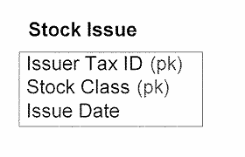
Compound Primary Key
A compound primary key is a primary key that is composed of two or more identifying attributes.
All attributes in a compound primary key are needed to uniquely identify an occurrence.
Notes:
A compound primary key is a primary key that is composed of two or more identifying attributes.
The features of compound primary key are:
All attributes in a compound primary key are needed to uniquely identify an occurrence.
There can not be null in any attribute.
The record should be dependant on all the attributes of primary key and not on the part of the primary key.
Generally the strong entity type which has its existence of its own has single attribute as primary key. While the weak entity type, related or dependant entity type has compound primary key. For e.g. The employee has Employee Id as primary key whereas The employee location has employee id, location, start date as compound key.
The stock has stock class as primary key while the stock issue has Stock class and issuer tax id both as primary key.

Slide 13
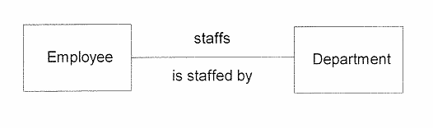
Relationship – Definition & Example
A relationship represents a direct business rule or association between two entity types.
A relationship is modeled using a line drawn between two entity types.
Notes:
What is relationship:
It is a direct business rule or association between two entity types.
The relationship contains relationship phrase, relationship cardinality and relationship participation or Optionality.
The relationship phrase is small description of relationship.
It is modeled using a line drawn between two entity types.
The data model defines the business rules that govern the area under study. The most data oriented business rules can be modeled as relationships between entity types.
In the example shown, the business rule is: Employee belongs to a department.
This is represented as Department staffs employee, or Employee is staffed by the department relationship phrase.

Slide 14
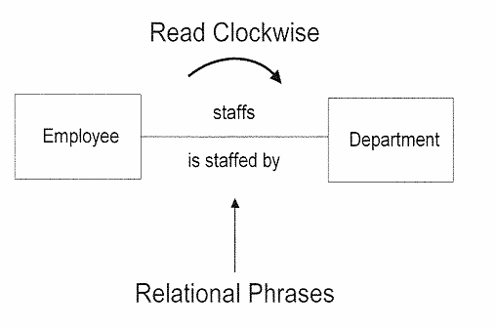
Relationship Phrase Example
Each relationship has two phrases.
The relationship phrase is read clockwise around a relationship.
The phrase provides meaningful context to the relationship and must reflect the nature of the association between entity types in business terms.
Notes:
Each relationship has two phrases.
It shows two reciprocal relationship.
Employee is staffed by Department.
Department staffs Employee.
Generally the relationship phrase is read clockwise around a relationship.
The phrase should be small and it should truly define the relationship context.
The context between employee and department is belongingness or staffing or working or managing.
The phrases can be Employee is staffed by Department. Employee belongs to department, Employee works for Department or Employee manages the department.
It should not be like Department has 100 or 200 staffs.
The relationship phrase need not include cardinality or participation or optionality details.

Slide 15
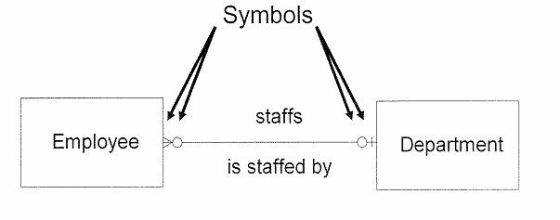
Relationship Cardinality
Cardinality expresses the minimum and maximum number of related occurrences between two related entity types.
It is defined by the symbols used at the both ends of the relationship line.
Notes:
Cardinality expresses the minimum and maximum number of related occurrences between two related entity types.
It can be also expressed as numeric relationship between two entity types.
The minimum occurrence is zero and maximum occurrence is more than 1.
The zero, one or many cardinality is shown by symbols at both end of the relationship line. Information Engineering specified notation is used here.
In this example , we see that zero, one or more employee are staffed by zero or one Department.
The cardinality is established according to business rule. It is enforced with constraints in physical data model or at application level.
For e.g. the business rule says that employee must be assigned to a department. Then while adding an employee record it will ensure that department information is also supplied with it. It can be enforced with not null constraint in data model.

Slide 16
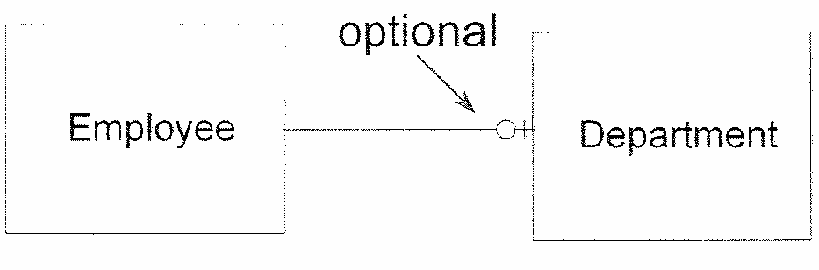
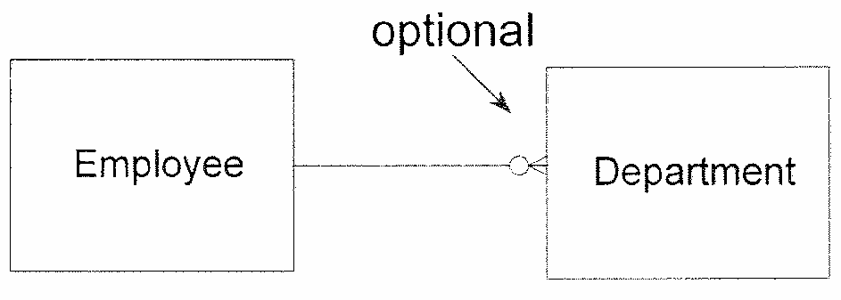
Relationship Optionality
Zero or one occurrence of Dept per Employee
Zero, one or many occurrence of Dept per Employee
Optionality expresses the minimum number of occurrences that may be related to one another.
If it appears on the relationship line, it means that the minimum number of related occurrences is zero (i.e. the relationship is optional).
If it does not appear, it means the relationship is mandatory.
Notes:
Relationship Optionality expresses the minimum number of occurrences that relate one entity type to other.
If it appears on the relationship line, it means that the minimum number of related occurrences is zero, or the relationship is optional. If it does not appear, it means the relationship is mandatory.
The relationship optional feature shows that for every occurrence of one entity there may not be occurrence of other entity.
In the first example it shows that Employee can belong to one department or none of the departments.
In the second example it shows that Employee can belong to one department or multiple departments or none of the departments.
The IE cardinality notation is used here. It is represented by circle.
This feature also arises from business rules. In data model for this attribute the not null is not enforced.
Source of the Figure: The Business Data Modeling training course offered by Inteq Group.

Slide 17
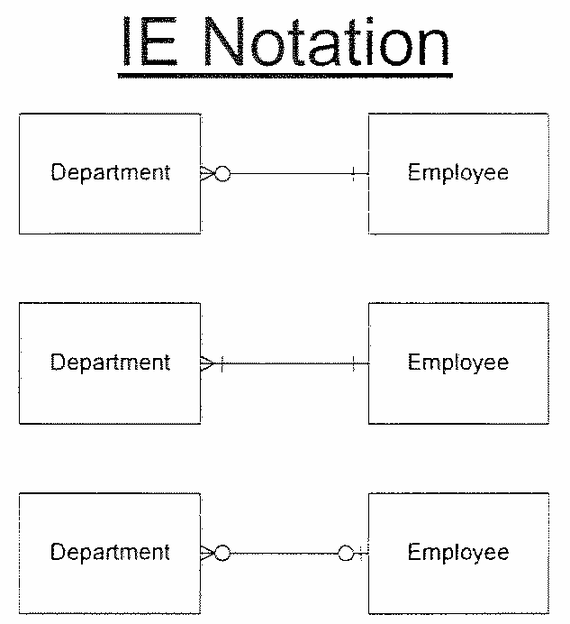
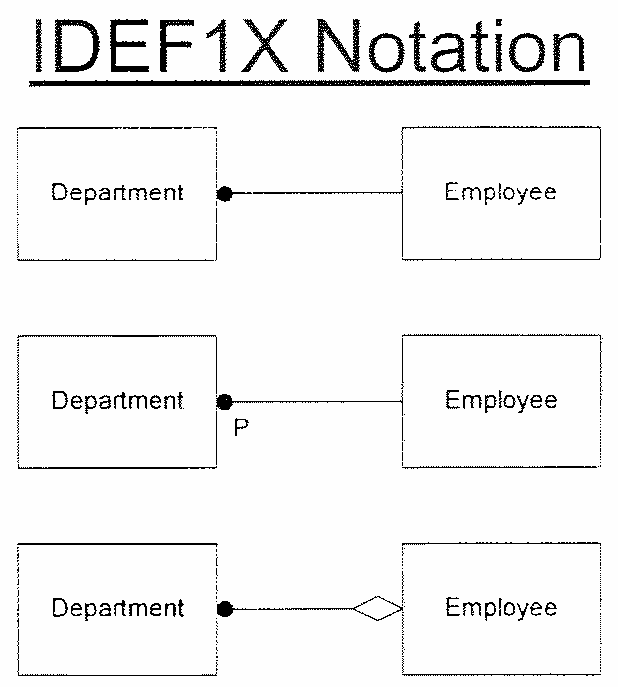
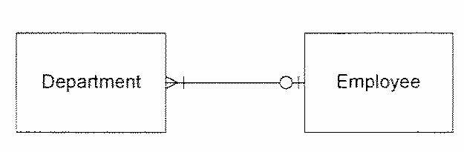

Relationship Notations-Information Engineering (IE) & IDEF1X
Integrated Definition for Information Modeling (IDEFIX) is a different notation developed by the federal government and supported by several modeling tools.
While the notation looks quite different, the above examples show the equivalent translation.
Notes:
These are the two widely followed relationship notations.
IE is the Integration Engineering notation.
Integrated Definition for Information Modeling (IDEFIX) is a notation developed by the federal government and supported by several modeling tools.
Apart from these there are several other notation types like Chen style, Martin style, Bachman style etc.
They all deal with the same stuff as showing cardinality of the relation and optionality of the relation.
The IE notation is used more widely.

Slide 18
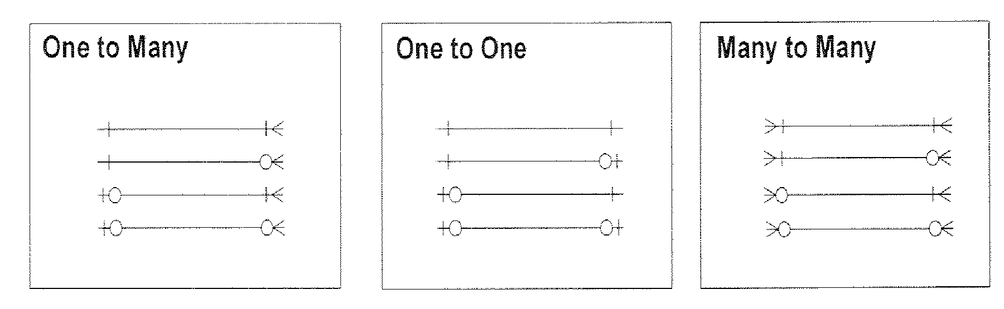
Relationship Types
With only two symbols for cardinality and one symbol for optional, all of the possible combinations are represented in the above categories.
The categories are based on the maximum symbol at both ends of the relationship as one-to-many(1:M),one-to-one(1:1),many-to-many(M:M).
Notes:
There are three relationship types. One to Many, One to One and Many to Many.
In each type again with change in cardinality more combinations are possible and they are listed here.
In IE approach there are two symbols for cardinality and one symbol for optional. Let us see the possible combinations for cardinality and optionality.
The first relationship type in one-to-many category shows one to one or many relation
The second relationship type in one-to-many category shows one to zero, one or many relation
The third relationship type in one-to-many category shows one or zero to one or many relation
The forth relationship type in one-to-many category shows one or zero to zero, one or many relation
The first relationship type in one-to-one category shows one to one relation
The second relationship type in one-to-one category shows one to zero or one relation
The third relationship type in one-to-one category shows zero or one to one relation
The forth relationship type in one-to-one category shows zero or one to zero or one relation
The first relationship type in many-to-many category shows one or many to one or many relation
The second relationship type in many-to-many category shows one or many to zero, one or many relation
The third relationship type in many-to-many category shows zero, one or many to one or many relation
The forth relationship type in many-to-many category shows zero, one or many to zero, one or many relation

Slide 19
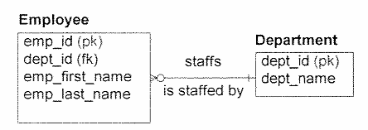
Foreign Key – Definition & Example
To implement a relationship between two entity types, the primary key of one entity type is copied to the related entity type.
The migrating primary key is called a Foreign key in the entity type to which it migrates.
Foreign keys are marked with “(fk)”.
Notes:
The definition of foreign key can be constructed as: To implement a relationship between two entity types, the primary key of one entity type is copied to the related entity type. The migrating primary key is called a Foreign key in the entity type to which it migrates.
It allows one to navigate through the data model. The foreign key enforces referential integrity. The entity type having foreign key cannot have any data if it is not present in the entity type which it is referred. For e.g. In employee entity type the non existing department can not be kept. It helps in maintaining data quality.

Slide 20
Foreign Key Rules
One-to-many relationships-migrate the entire primary key from the one side to the many side.
One-to-one relationships-migrate the entire primary key from the mandatory side to the optional side.
Many-to-many relationships-resolve the relationship first then migrate.
Notes:
The rules for foreign key are:
One-to-many relationships-migrate the entire primary key from the one side to the many side.
One-to-one relationships-migrate the entire primary key from the mandatory side to the optional side.
Many-to-many relationships-resolve the relationship first then migrate.
Many-to-Many relationship is resolved by two one to many relationships.
The migration of attribute from referenced entity type means presence of attribute in referencing table also.
Foreign key is allowed to contain null. This is used to show optionality feature. For e.g. An employee may not be assigned to any department, so he will have null in the department id.
Sometimes it is possible that the referencing and referenced tables are same. For e.g. the manager attribute in employee entity type. The manager id is also employee id. And the employee to manager relation refer to same table.
An entity type can have multiple foreign keys, which refer to different entity types.

Slide 21
Data Modeling in Data warehouse
Notes:
Now we are in the last lesson of the data modeling concepts. The use of data modeling in data warehouse.
The data warehouse environment is different than the transactional environment.
While in the transactional environment the stress is on quicker processing of small amount of data and very high frequency of data updates and deletes; in data warehouse it is just opposite; processing large amount of data and very few updates or deletes.
As the data processing requirement is different , we use data modeling. Here the dimensional modeling approach is followed. It is marked with less number of entity types and allowed data redundancy.

Slide 22
Data Modeling In DWH Environment
A DWH Environment
Involves multiple (viz. source, staging & target) layers of data storages.
Each layer has unique data modeling requirements.
S1
Data Mart
Data
Warehouse
Staging
OLAP
S2
Data Mart
S3
Reports
Notes:
The typical DWH environment has source, Staging, Data Warehouse and Data Mart area where data is kept while processing.
The data model design differs for each of them.
The operational data which is lying in operation stores like S1, S2 and S3 is mostly transactional data. It follows relational data model and data redundancy is avoided.
The data is passed from operational area to staging area.
Here the data is stored mostly as it comes from operational source. It is used for data validation. It follows the similar structure of source system. It is a temporary data storage area. The data is deleted once it is processed and passed to data warehouse.
The data warehouse has mixed modeling approach of relational modeling and dimensional modeling.
From data warehouse it is moved to Data mart which is specific to a business process. The data here is kept in denormalized form. It is mostly in dimensional model or flat model.
From data mart the reports are created or the data can be pulled by OLAP system for reporting.

Slide 23
Data Modeling In DWH Environment
Data Modeling Approaches
Entity Relational approach
Traditional modeling technique (more normalized)
Technique of choice for OLTP
Suits for corporate data Warehouse
Goals
Eliminate redundancy
Transaction efficiency
Dimensional Approach
Analyzing business measures in the specific business context (using STAR schema)
Helps visualize very abstract business questions
End users can easily understand and navigate the data structure
Goals
Query performance
Ease of understanding /Use
Notes:
Let us understand the differences of relational and dimensional modeling:
Relational approach is more suited for Traditional modeling technique, OLTP and corporate data warehouse
The goal here is to eliminate redundancy of data and have better transaction efficiency. A lot of update, insert and delete operations are performed by many users.
So transactions should be fast.
Dimensional Approach is more suited for analyzing business measures in the specific business context for example sales by city, sales by state, sales by country, sales by region etc.
Helps visualize very abstract business questions and it is easy for end users to understand and navigate through the data structure.
To achieve this, the related master tables data is stored in one table and is termed as dimension. For e.g. The data from multiple tables of city, state, country, region of source system are stored in Location Dimension. This increases the data redundancy but it improves the query performance and user sees all the data at one place.
The goal here is to provide query performance and ease of understanding for the end user.
For the ease of user understanding the descriptions are spelled out fully. For e.g. Employee’s Employment Type which can come from source system as T and P will be recorded as ‘T’emporary and ‘P’ermanent.

Slide 24
Module Summary
Congratulations! You have now completed the 3rd and final part of the module “Data Model Concepts”
You should now be able
To understand the terms and concepts of Data Models.
To understand the Primary key, Foreign Key
To understand Relationships
To understand the DWH environment
Notes:
This course would have helped you understand the basic construct of data modeling. How the business rules are applied with the relationship notation. Definition and usage of Primary key foreign key and an overview of Data warehouse environment.
With this, we now come to the end of the Data modeling series of presentations.
Like always, we have a small quiz lined up for you in the next few slides. Go ahead, and check how much you have understood.
Wish you a GOOD LUCK. Thanks, bye.

Slide 25
Quiz
Notes:
© 2009 Wipro Ltd – Internal & Restricted
‹#›

Slide 26
Question 1
Which is not the feature of primary key
It can contain null value
It uniquely defines a record
An entity set can have only one primary key
Primary key can be combination of multiple attributes
Notes:
© 2009 Wipro Ltd – Internal & Restricted
‹#›

Slide 27
Question 1
Which is not the feature of primary key
It can contain null value
It uniquely defines a record
An entity set can have only one primary key
Primary key can be combination of multiple attributes
Answer: A
Notes:
© 2009 Wipro Ltd – Internal & Restricted
‹#›

Slide 28
Question 2
Which is not the correct statement for foreign key rule
One-to-many relationships-migrate the entire primary key from the one side to the many side
One-to-one relationships-migrate the entire primary key from the mandatory side to the optional side
Many-to-many relationships-resolve the relationship first then migrate
Many-to-many relationships- relationships-migrate the entire primary key from the mandatory side to the optional side
Notes:
© 2009 Wipro Ltd – Internal & Restricted
‹#›

Slide 29
Question 2
Which is not the correct statement for foreign key rule
One-to-many relationships-migrate the entire primary key from the one side to the many side
One-to-one relationships-migrate the entire primary key from the mandatory side to the optional side
Many-to-many relationships-resolve the relationship first then migrate
Many-to-many relationships- relationships-migrate the entire primary key from the mandatory side to the optional side
Answer: D
Notes:
© 2009 Wipro Ltd – Internal & Restricted
‹#›

Slide 30
Question 3
Which is not part of relationship definition
It has relationship phrase
It has relationship link
It has relationship cardinality
It has relationship option/participation
Notes:
© 2009 Wipro Ltd – Internal & Restricted
‹#›

Slide 31
Question 3
Which is not part of relationship definition
It has relationship phrase
It has relationship link
It has relationship cardinality
It has relationship option/participation
Answer: B
Notes:
© 2009 Wipro Ltd – Internal & Restricted
‹#›

Slide 32
Question 4
Following Employee and dept relation of a company is depicted as
Employee may belong to only one dept of the company or may not belong to any dept. The dept can have multiple employee
Employee belong to multiple dept. The dept can have multiple employee
Employee belong to only one dept. Dept can have multiple employee
Employee belong to only one dept, dept has only one employee.
Employee
Dept
Notes:
© 2009 Wipro Ltd – Internal & Restricted
‹#›

Slide 33
Question 4
Following Employee and dept relation of a company is depicted as
Employee may belong to only one dept of the company or may not belong to any dept. The dept can have multiple employee
Employee belong to multiple dept. The dept can have multiple employee
Employee belong to only one dept. Dept can have multiple employee
Employee belong to only one dept, dept has only one employee.
Answer: A
Employee
Dept
Notes:
© 2009 Wipro Ltd – Internal & Restricted
‹#›

Slide 34
Question 5
In Data Warehouse environment which of the following is not included
Staging Area
Transaction Processing (OLTP)
Enterprise Data Warehouse
Data Mart
Notes:
© 2009 Wipro Ltd – Internal & Restricted
‹#›

Slide 35
Question 5
In Data Warehouse environment which of the following is not included
Staging Area
Transaction Processing (OLTP)
Enterprise Data Warehouse
Data Mart
Answer: B
Notes:
© 2009 Wipro Ltd – Internal & Restricted
‹#›

Slide 36
References

Slide 37
References
Publications
Courses
Course structure was conceptualized from Business Data Modeling training course offered by Inteq Group
Fundamentals of Database Systems by R Elmasri, S Navathe, Publisher - Addison Wesley
DWH Concepts
URL’s
Training Programs
www.learndatamodeling.com
www.agiledata.org
Wipro Data warehousing Training Material

Slide 38
Thank You
Anand Kumar
Project Lead
Anand.akumar@wipro.com

